Slide 1
Mandate Mockup Screens
1) TPPD Mandate Approval
2) TPBI Mandate Approval
3) OD Mandate Approval

Slide 2
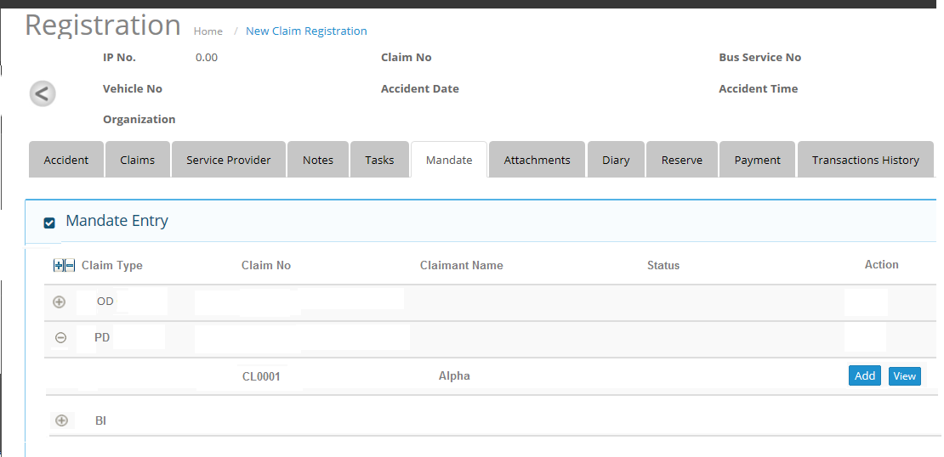
1) TPPD Mandate Approval
1.1) Header and Grid Section

Slide 3
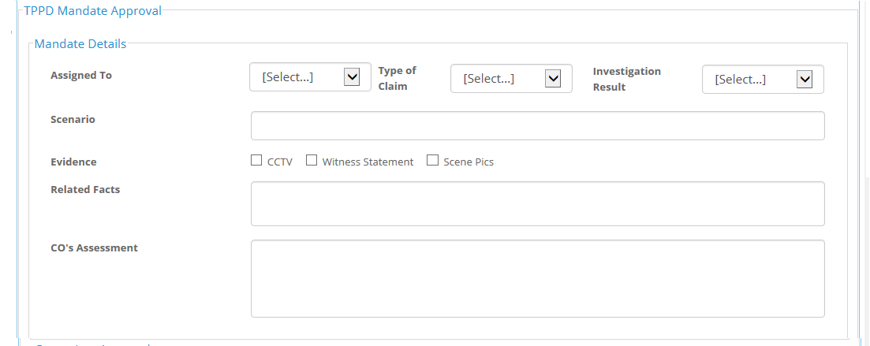
1.2) Mandate Details section under TPPD Mandate Approval Frame

Slide 4
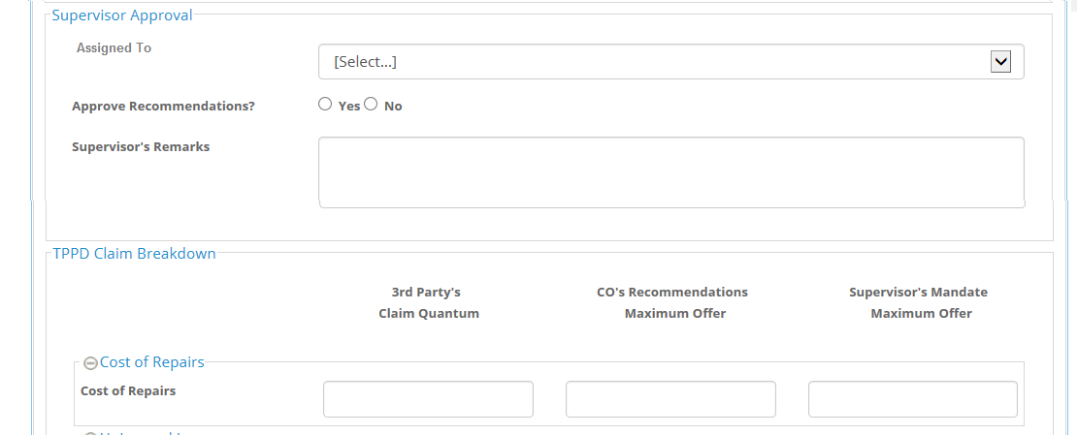
1.3) Supervisor Approval section and Cost of Repairs section

Slide 5
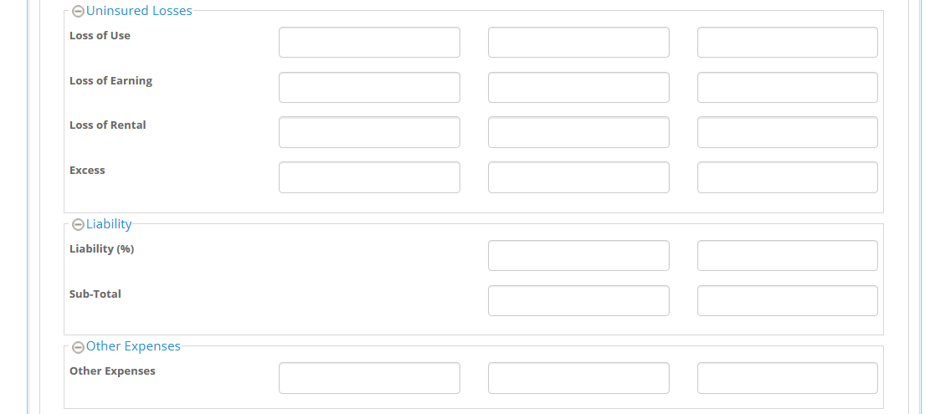
1.4) Uninsured Losses , Liability, Other Expenses sections

Slide 6
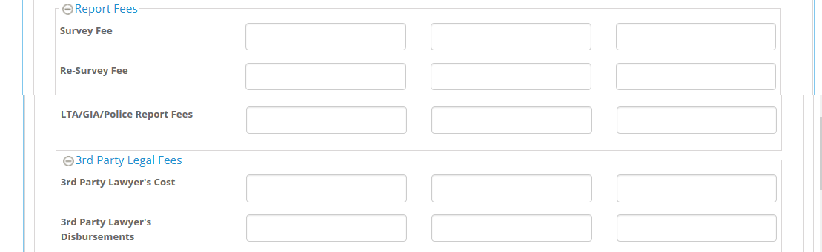
1.5) Report Fees , 3rd Party Legal Fees sections

Slide 7
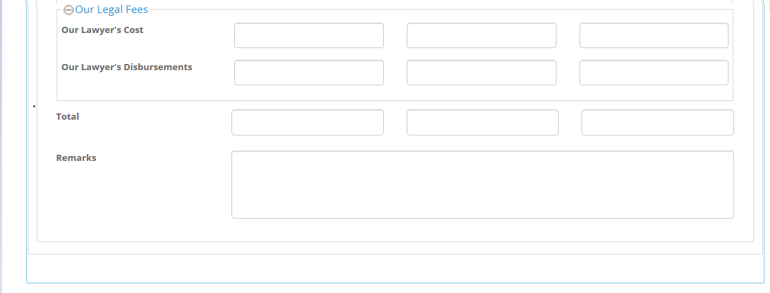
1.6) Our Legal Fees Section

Slide 8
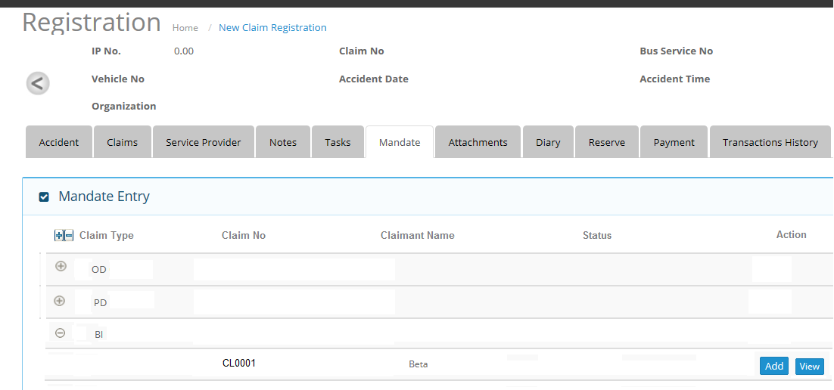
2) TPBI Mandate Approval
2.1) Header and Grid Section

Slide 9
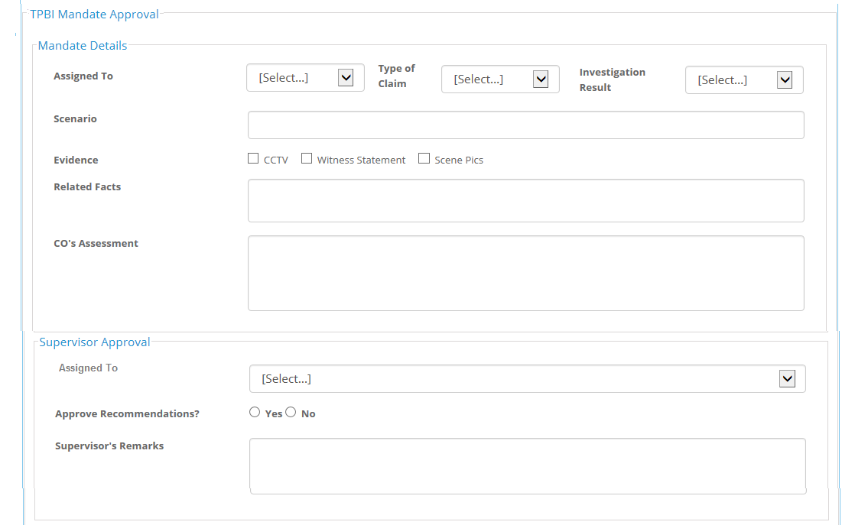
2.2) Mandate Details and Supervisor Approval Sections under TPBI Mandate Approval Frame

Slide 10
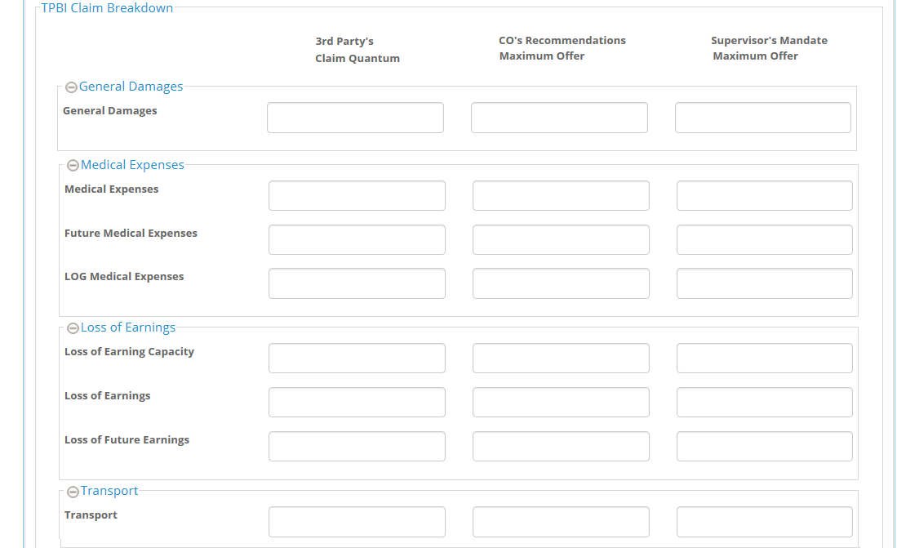
2.3) General Damages, Medical Expenses and Loss of Earnings Sections under TPBI Claim Breakdown Frame

Slide 11
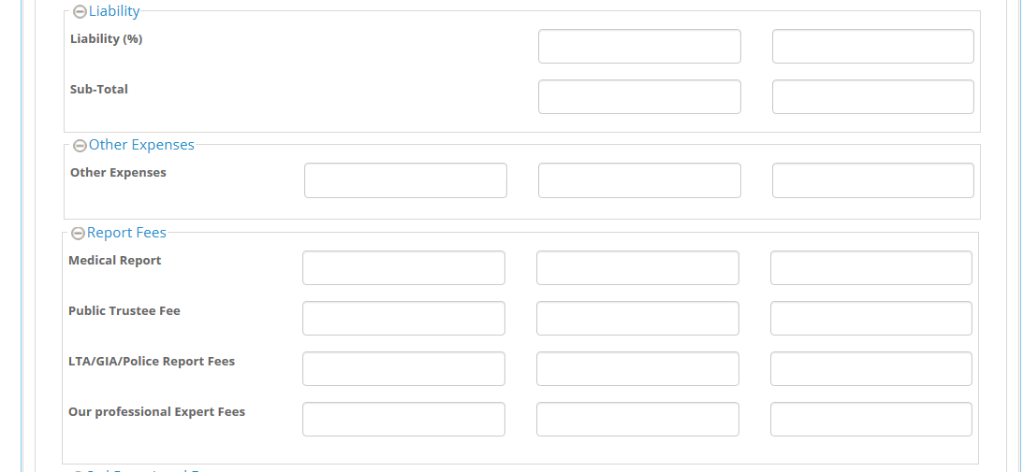
2.4) Liability, Other Expenses and Report Fees Sections

Slide 12
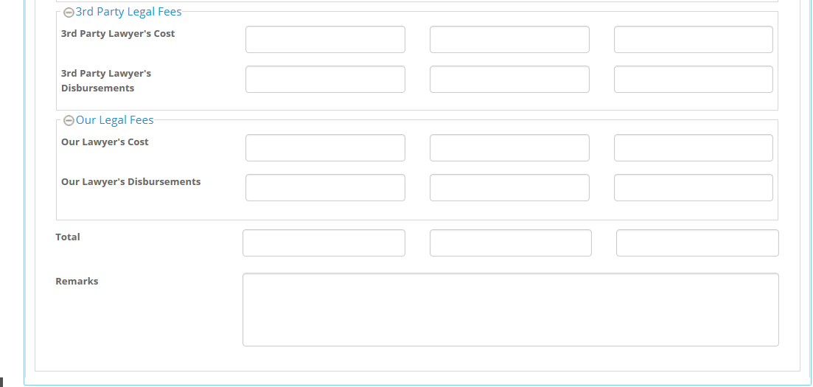
2.5) 3rd Prty Legal Fees and Our Legal fees Sections

Slide 13
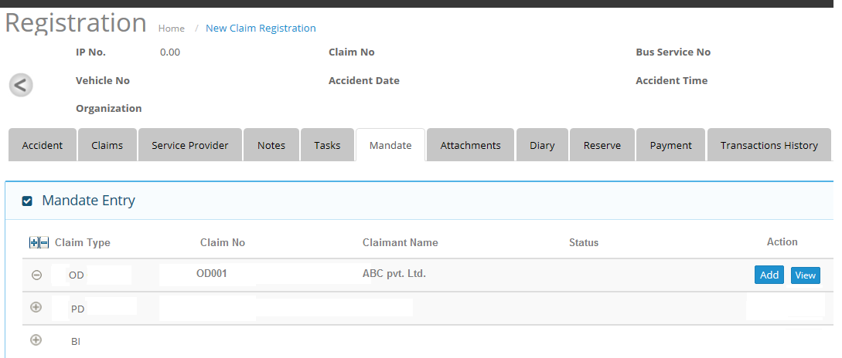
3) OD Mandate Approval
3.1) Header and Grid Details section

Slide 14
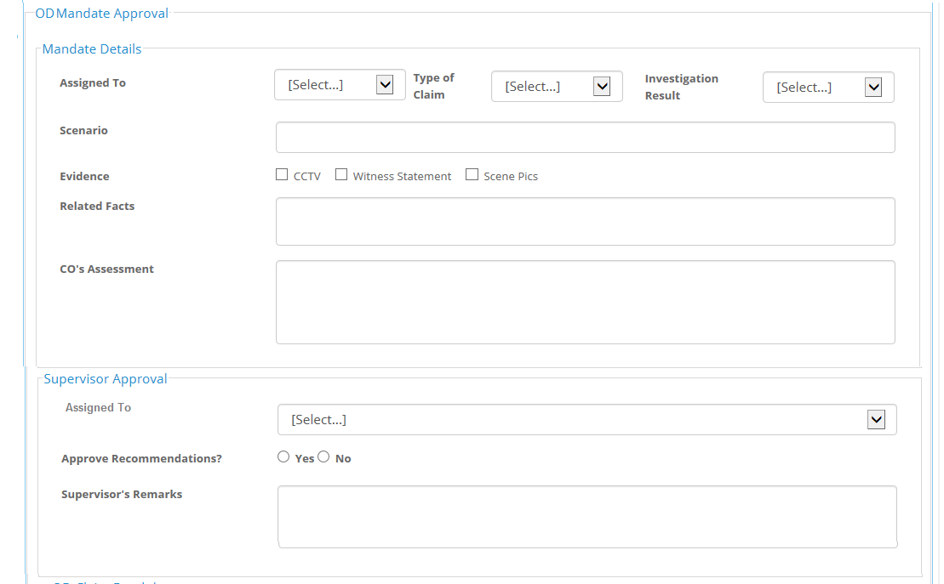
3.2) Mandate Details and Supervisor Approval sections under OD Mandate Approval frame

Slide 15
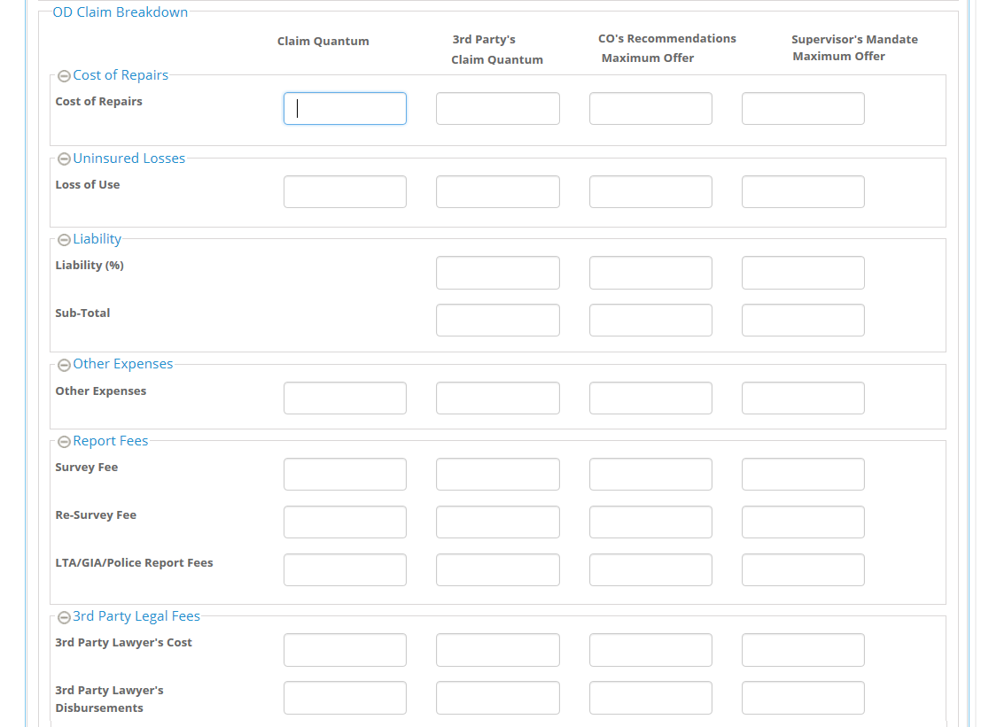
3.3) Cost of Repairs, Uninsured Losses , Liability , Other Expenses and Report fees sections

Slide 16
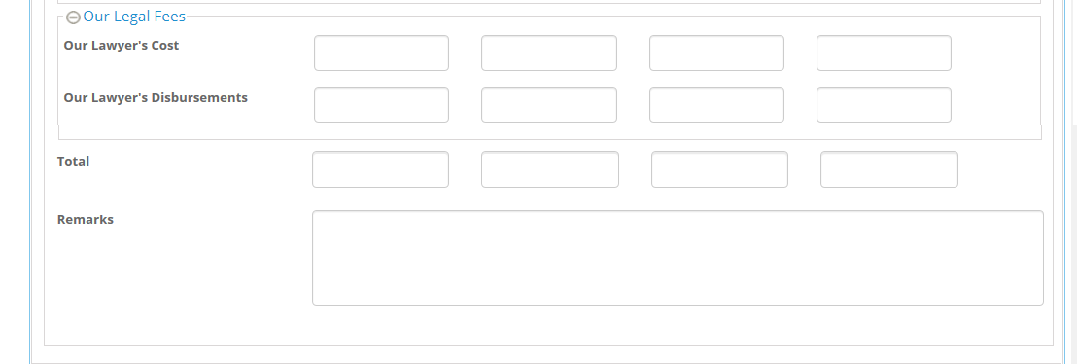
3.4) Our Legal Fees Section

Slide 17
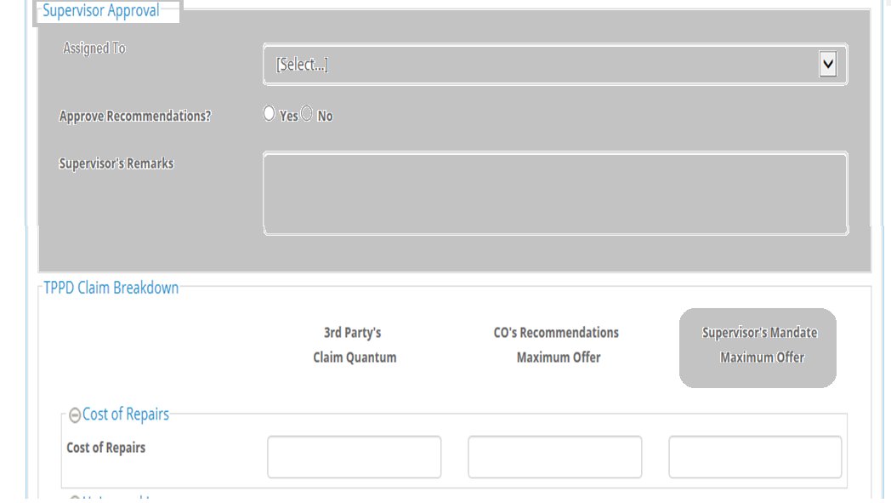
Note: For CO Group user , Supervisor approval and supervisor mandate maximum order sections will be grayed out

